Slide 1

다양한 2차원 그래프
매트랩 이해 및 실습
최병조
임베디드시스템공학과

Slide 2
강의 주제
Matlab의 역사와 간단한 사용법 | 다항식, 커브 피팅, 인터폴레이션
배열, 행렬 만들기와 소리 다루기 | 3차원 그래프 그리기
행렬과 그림 다루기 | GUIDE로 GUI 만들기
라이브스크립트, 웹 게시, 엑셀 연동 | 애니메이션 GUI
2차원 그래프 그리기 기초 | 앱 디자이너로 GUI 만들기
다양한 2차원 그래프 그리기 | GUI 프로젝트 발표
함수 만들기 | MuPAD로 수학 문제 풀기
중간고사 | 기말고사

Slide 3
You will be able to
Visualize data using various plots including bar, stem, stairs, pie, histogram and polar plots,
Use patch plots with colors,
Generate an animated graph.

Slide 4
Special Graphs: Bar Charts
year = 2000:2006;
sales = [8 12 20 22 18 24 27 ];
bar( year, sales,'r');
xlabel('Year');
ylabel('Sales (Millions)');
barh( year, sales,'b');
ylabel('Year');
xlabel('Sales (Millions)');

Slide 5
Multiple Bars
Each column represents a bar chart.
Different colors are assigned to different columns.
a=rand(5,4);
bar( a );
grid on;

Slide 6
Special Graphs: Stairs & Stem
year = 2000:2006;
sales = [8 12 20 22 18 24 27 ];
stairs( year, sales);
xlabel('Year');
ylabel('Sales (Millions)');
stem( year, sales,'filled');
xlabel('Year');
ylabel('Sales (Millions)');

Slide 7
Pie Chart
Class Grades
①
⑤
If the sum of values > 1, it display percentage.
7%
16%
13%
F
④
A
D
grades = [ 11 18 26 9 5];
pie(grades,[ 0 0 0 1 0]);
title('Class Grades');
②
B
26%
C
③
38%

Slide 8
Pie Chart
p(2)
If the sum of values ≤ 1, it displays the values.
p(1)
grades = [ 11 18 26 9 5]*0.01;
figure(2);
p = pie(grades,[ 0 0 0 1 0]);
p(7).LineStyle = '-.';
p(8).String = '9% (Science)';
p(8).Color = [1 0 0];
p(4)
p(3)
p(10)
p(9)
p(5)
p(7)
p(6)
p(8)

Slide 9
Example: World Pop. in Y2150
Represent the predicted world population in year 2150 in a bar chart and a pie chart.
Get the raw data from Wikipedia
Visit http://en.wikipedia.org/wiki/World_population
Draw a bar chart and a pie chart based on the data.
Use subplot to place the two charts side by side.
Use sensible legend or tick label.

Slide 10
Sample Graph

Slide 11
Sample Script
world_population.m
PopData = [ 2308, 5561, 517, 912, 398, 51 ];
figure('Position', [100, 400, 900, 400] );
subplot(1,2,1); barh(PopData); grid on;
ax = gca; ax.YTickLabel = {'Africa', 'Asia', 'Europe', 'Latin America', ...
'North America', 'Oceania'};
ax.YDir = 'reverse';
xlabel('Milions');
subplot(1,2,2); pie(PopData);
legend( 'Africa', 'Asia', 'Europe', 'Latin America', 'North America', ...
'Oceania', 'Location', 'SouthEast' );

Slide 12
Histogram (1/2)
Number of occurrences in each bin.
The default number of bins is 10.
s=randn(1,1000);
hist(s)
s=randn(1,1000);
hist(s, 20)

Slide 13
Histogram (2/2)
Histogram of a Matrix
Use of histogram data
s=randn(1,1000);
[n x ] = hist(s);
stem(x,n,'filled'); hold on;
plot(x,n,'r-.');
s=randn(1000);
hist(s)

Slide 14
Polar Plot
polar(theta, radius, 'line spec' )
90
1
polar_pie.m
120
60
0.8
t = 0:0.01:pi/4;
th = [t 0 0 ];
r = [ones(1,length(t)) 0 1 ];
h = polar( th, r, 'r-');
set(h,'LineWidth',3);
0.6
150
30
0.4
0.2
180
0
210
330
240
300
270

Slide 15
More Polar Plots
90
80
90
1
120
60
120
60
60
0.8
0.6
150
40
30
150
30
0.4
20
0.2
180
0
180
0
210
330
210
330
240
300
240
300
270
270
polar_spiral.m
polar_petal.m
th = 0:0.01:20*pi;
h = polar(th,th,'r-');
set(h, 'LineWidth',3);
th = 0:0.01:4*pi;
r = sin(4.5*th);
h = polar(th,r,'r-');
set(h, 'LineWidth',2);

Slide 16
Polar / Plot / Patch
90
1
1
1
120
0.8
60
0.8
0.8
150
0.6
30
0.6
0.6
0.4
0.4
0.4
0.2
0.2
0.2
180
0
0
0
-0.2
-0.2
-0.4
-0.4
210
330
-0.6
-0.6
-0.8
-0.8
240
300
-1
-1
270
-1
-0.5
0
0.5
1
-1
-0.5
0
0.5
1
Polar
Plot
Patch

Slide 17
Script for Polar / Plot / Patch
polar( , ) ⬅➔plot( , )
patch( , , Color)
polar_patch_demo.m
% Polar, Plot and Patch demo
%% a wing
t1 = 0:0.01:pi/3; % counter-clockwise
tr = t1(end:-1:1); % reverse direction
nt = length(t1);
th = [t1 tr 0];
r1 = [ones(1,nt) 0.3*ones(1,nt) 1];
%% a circle
t2 = 0:0.01:2*pi;
r2 = ones(1,length(t2));
%% Polar
figure(1);
h1 = polar( th, r1, 'r-'); hold on;
h2 = polar( th+2/3*pi, r1, 'r-');
h3 = polar( th-2/3*pi, r1, 'r-');
h0 = polar( t2, 0.25*r2, 'r-');
set([h0 h1 h2 h3], 'LineWidth', 3);
hold off;
%% Plot
figure(2);
h1 = plot( r1.*cos(th), r1.*sin(th), 'r-'); hold on;
h2 = plot( r1.*cos(th+2/3*pi), r1.*sin(th+2/3*pi), 'r-');
h3 = plot( r1.*cos(th-2/3*pi), r1.*sin(th-2/3*pi), 'r-');
h0 = plot( 0.25*r2.*cos(t2), 0.25*r2.*sin(t2), 'r-');
set([h0 h1 h2 h3], 'LineWidth', 3);
axis square;
hold off;
%% Patch - filled polygons
figure(3);
h1 = patch( r1.*cos(th), r1.*sin(th), 'k'); hold on;
h2 = patch( r1.*cos(th+2/3*pi), r1.*sin(th+2/3*pi), 'k');
h3 = patch( r1.*cos(th-2/3*pi), r1.*sin(th-2/3*pi), 'k');
h0 = patch( 0.25*r2.*cos(t2), 0.25*r2.*sin(t2), 'k');
set(gca,'Color','yellow');
axis square;
hold off;

Slide 18
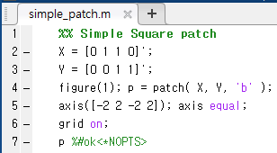
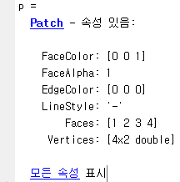
Basics of Patch
Blue Square

Slide 19
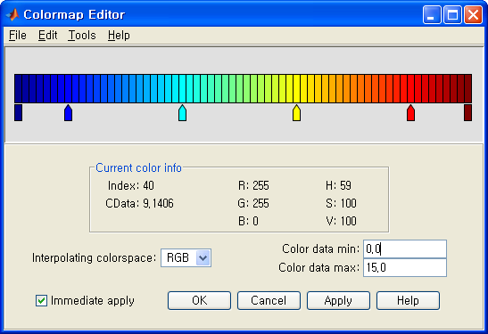
Coloring Patches
(2,8)
5 Triangles
patch_demo.m
xdata = [2 2 0 2 5;
2 8 2 4 5;
8 8 2 4 8];
ydata = [4 4 4 2 0;
8 4 6 2 2;
4 0 4 0 0];
cdata = [9 0 4 6 10;
15 2 5 7 9;
8 3 0 8 3];
% colormapeditor
figure(1);
p = patch(xdata,ydata,cdata, ...
'Marker','o','MarkerFaceColor','flat', ...
'FaceColor','none');
set(p,'EdgeColor','interp');
colormapeditor
interp

Slide 20
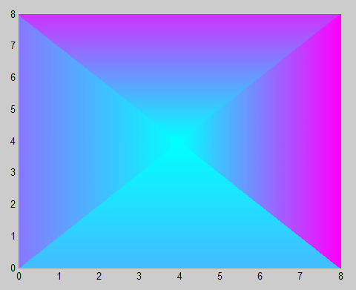
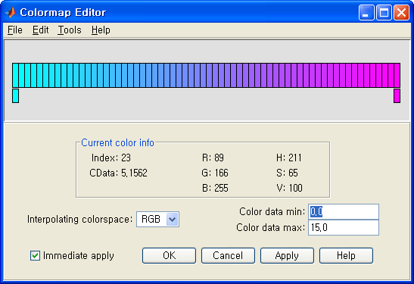
Patch Pyramid
patch_pyramid.m
4 Triangles
cdata 0
xdata = [0 0 0 8;
8 0 8 8;
4 4 4 4];
ydata = [0 0 8 8;
0 8 8 0;
4 4 4 4];
cdata = [4 8 12 15;
4 8 12 15;
0 0 0 0];
% Select the current colomap
colormap('Cool');
figure(1);
p = patch(xdata,ydata,cdata,'FaceColor','interp');
set(p,'EdgeColor','interp');
(4,4)

Slide 21
Exercise: Color Ball
Write a script for plotting the color ball below using patch.

Slide 22
Your Solution
Script and Screenshot
patch_color_ball.m
% Color Ball
t0 = 0:0.01:pi/2; t = [ 0 t0 ];
N = length(t);
r = [ 0 ones(1,N-1) ];
x = r .* cos(t); y = r .* sin(t);
u = r .* cos(t+pi/2); v = r .* sin(t+pi/2);
X = [x' u' u' x' ];
Y = [y' v' -v' -y' ];
I = ones(N,1);
figure(1); colormap('colorcube');
set(gca,'CLim',[0 64]);
C = I*[ 55 7 3 49];
colormap('colorcube');
p = patch(X, Y, C, 'FaceColor', 'flat');
axis square;

Slide 23
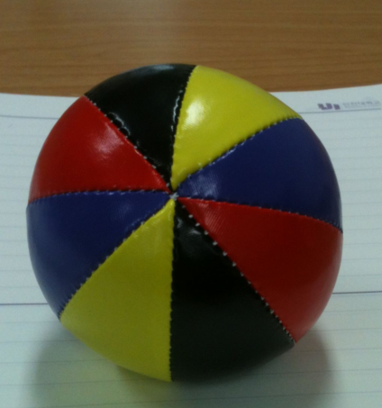
Exercise: Juggling Ball
Write a script for plotting the color juggling ball below using patch.

Slide 24
Your Solution
Script and Screenshot
patch_jcolor_ball.m

Slide 25
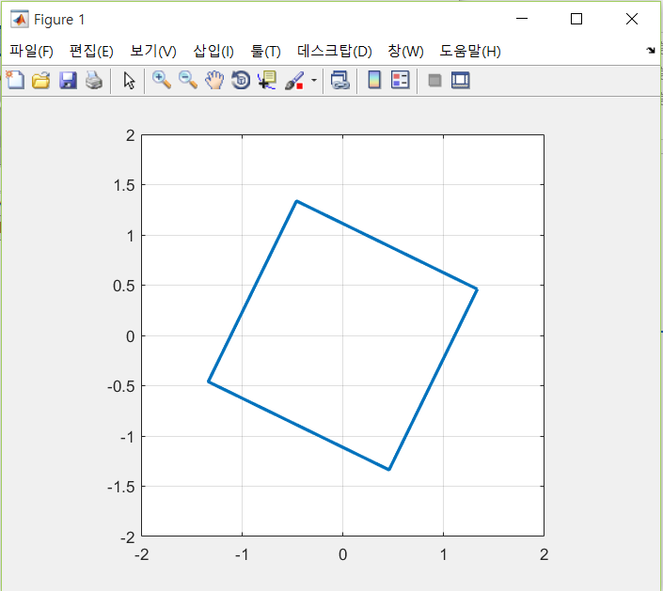
Rotating Square
Read https://en.wikipedia.org/wiki/Rotation_matrix
Run the script below.
patch_jcolor_ball.m
% Rotating Square
x = [1 1 -1 -1 1];
y = [-1 1 1 -1 -1];
figure(1);
for t = 0:0.1:10*pi
c = cos(t); s = sin(t);
R = [c -s; s c ];
P = R * [x; y];
plot( P(1,:), P(2,:), 'LineWidth', 2 );
axis([-2 2 -2 2]); axis square;
grid on;
pause(0.01);
end

Slide 26
Exercise: Fibonacci Plot
Write a script for generating a Fibonacci plot.
Refer to Wikipedia for Fibonacci number.
Number of arcs N may be arbitrary.
Bonus for arbitrary starting direction and rotation control.
25
20
15
10
5
0
-5
-10
-15
-20
-25
-25
-20
-15
-10
-5
0
5
10
15
20
25

Slide 27
Your Solution
Script and Screenshot
fibonacci_arcs.m

Slide 28
Subplot - Example
15
15
15
10
10
10
5
5
5
0
0
1
2
3
4
5
0
0
1
2
3
4
5
0
0
1
2
3
4
5
plot
stem
stairs
15
8%
90
10
18%
120
60
23%
150
5
30
10
180
0
20%
5
210
330
8%
240
270
300
0
0
1
2
3
4
5
25%
bar
pie
polar

Slide 29
Subplot - Script
sbuplots.m
% Subplot Demo
y = floor(10*rand(1,6))+3;
x = [1:length(y)] - 1;
subplot(2,3,1); plot(x,y,'b-'); axis([-0.5 5.5 0 15]);
subplot(2,3,2); stem(x,y,'filled'); axis([-0.5 5.5 0 15]);
subplot(2,3,3); stairs(x,y,'b-'); axis([-0.5 5.5 0 15]);
subplot(2,3,4); bar(x,y,0.75); axis([-0.5 5.5 0 15]);
subplot(2,3,5); pie(y,[0 0 0 0 0 1]);
subplot(2,3,6); polar([x x(1)]*2*pi/6,[y y(1)],'b-');

Slide 30
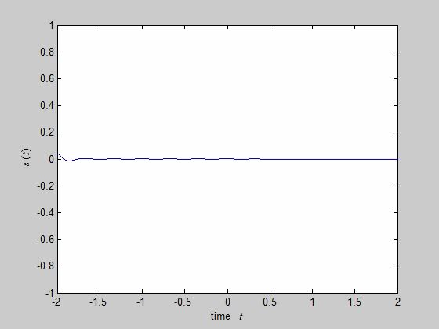
Exercise: Wave-packet
Plot the following moving graph using the following equation.
for
pause
Play

Slide 31
Your Solution
Script and Screenshot
wavepacket.m
t = -5:0.0001:5;
y = cos(2*pi*3*t) .* exp( -pi*t.^2 );
figure(1); plot( t-3, y );
xlabel('time $t$', 'Interpreter', 'latex');
ylabel('$s(t)$', 'Interpreter', 'latex');
axis([-2 2 -1 1]);
d = -3:0.05:3;
szD = length(d);
for di = 1:szD
plot(t+d(di), y );
xlabel('time $t$', 'Interpreter', 'latex');
ylabel('$s(t)$', 'Interpreter', 'latex');
axis([-2 2 -1 1]);
pause(0.05);
end

Slide 32
Exercise: Vector Field
Plot a vector field corresponding to the following differential equation.
meshgrid
quiver

Slide 33
Sample Solution
Script and Screenshot
vectorfield.m
[X, Y] = meshgrid(-2:0.2:2);
Dx = sin(Y);
Dy = sin(X);
figure(1), quiver(X, Y, Dx, Dy );
R = 1.5;
axis([-1 1 -1 1]*R);
xlabel('$x$', 'Interpreter', 'latex');
ylabel('$y$', 'Interpreter', 'latex');

Slide 34
Exercise – Taylor Series
The Taylor series expansions of may be written as;
Plot along with for .
Add annotations and a title, as shown on the right graph.

Slide 35
Sample Solution
Script and Screenshot
Taylor_of_sin.m
k = (1:2:13)';
nK = length(k);
s = (-1).^(0:nK-1);
t = -10:0.01:10;
nT = length(t);
X = zeros(nK+1, nT);
x = s(1) * t .^ k(1) / factorial(k(1));
X(1,:) = x;
for ki=2:nK
x = s(ki) * t .^ k(ki) ...
/ factorial(k(ki));
X(ki,:) = X(ki-1,:) + x;
end
X(nK+1,:) = sin(t);
f = figure(1);
h = plot( t, X' ); set( h(nK+1), 'LineWidth', 2 );
ylim([-10 10] ); grid on;
xlabel( '$t$', 'Interpreter', 'latex' );
title('Taylor Series Approximation of $\sin(t)$', ...
'Interpreter', 'latex');
annotation(f, 'textarrow', ...
[0.8 0.77], [0.47 0.52], ...
'TextEdgeColor','none', ...
'String',{'$\sin(t)$'}, 'Interpreter', 'latex');
annotation(f,'textarrow', ...
[0.59 0.63], [0.69 0.63], ...
'TextEdgeColor','none', ...
'String',{'$T(t,1)=t$'}, 'Interpreter', 'latex');

Slide 36
Summary
Recognize the following commands?
h = plot(x,y,'r-o');
set( h, 'LineWidth',2)
hold on
figure
figure(1)
set(gca, 'Color', 'yellow')
grid
axis square
title('KOSPI');
xlabel('{\it t}');
barh(X)
stem(t,y,'filled')
stairs(x,y)
polar(theta,rho)
box off
pie(data, [0 0 1 0])
patch(x,y,'k');
colormap('Cool')
legend('Theory','Data');
ezplot('cos(x)')
reshape(M,1,[])
repmat(N,2,1)
[s xbin] = hist(X)

